Slide 1
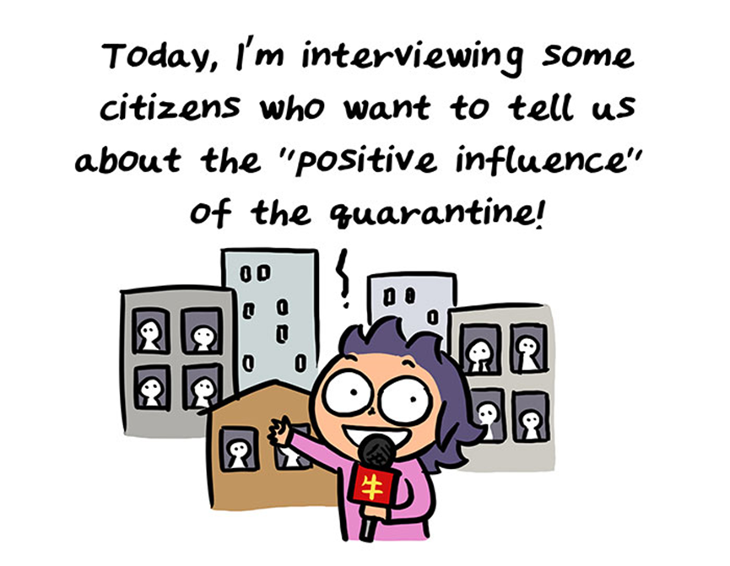
Being in Quarantine.

Slide 2
Vocabulary
Social distancing
COVID 19
Epidemic
Pandemic
Self-isolation
Abundance of caution

Slide 3

Covid-19
Corona Virus disease - 2019

Slide 4
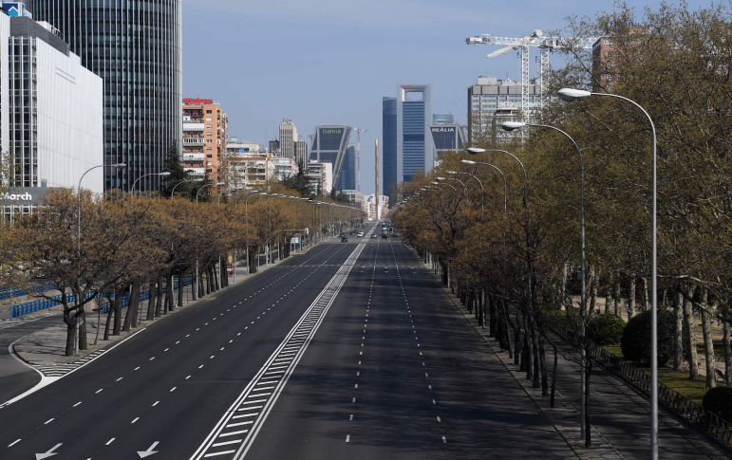
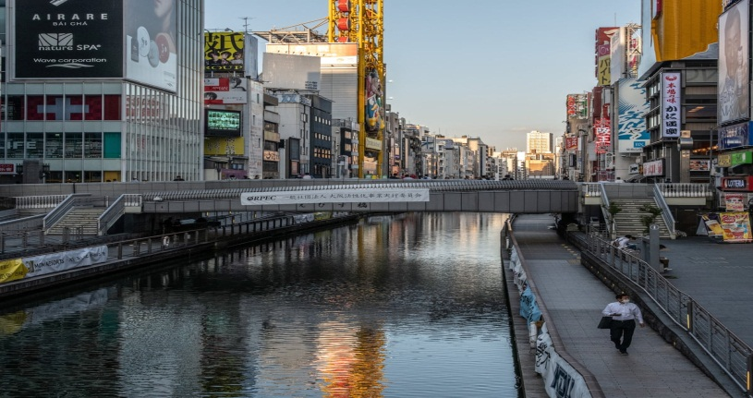
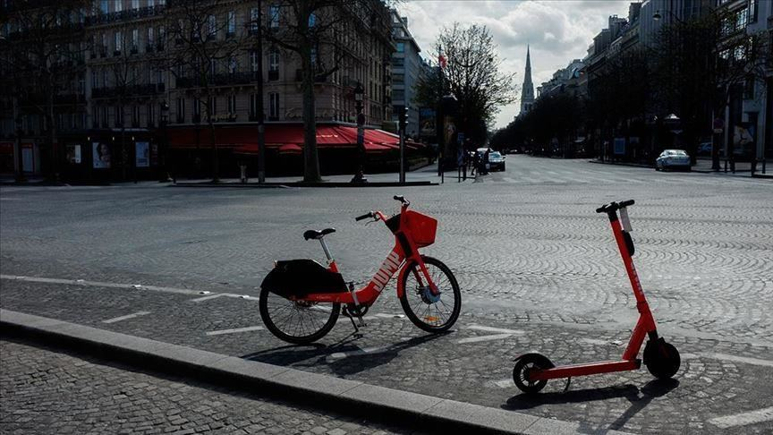
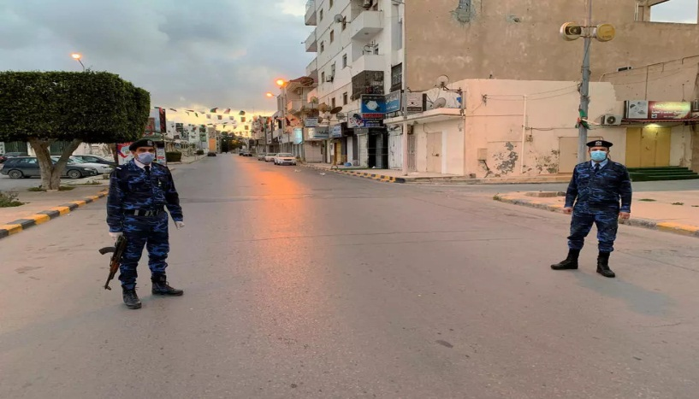
Lockdown

Slide 5
The advantages of being in quarantine
Cities will calm down.
The economy will take a break and, in some areas polluted air will have a chance to become clean again.
The government and businesses will finally take big steps towards home offices and telework.
Teachers and students will adapt to new ways of learning.
Many people will save money.
We will have time for our loved ones.
Spending quality time with other 'safe' friends on SKYPE or other video calls and video conference calls.
Watching TV with family members.
A chance to appreciate our home… home-cooking & other

Slide 6
The advantages of being in quarantine 2
We have free time, which we can spend reading books
Watching movies
Cooking
Learning new languages
Training

Slide 7
What should we never do during
“Social Distancing?”
Large group gatherings
Travelling
Mass transit systems like a bus, metro, trains, ferry boats.
Sleep overs
Concerts
Hanging out with friends

Slide 8
What should we never do during
“Social Distancing?” 2
Workout at the gym
Having visitors over at your house
Non-essential workers in your home, eg. painters
Trips to the theatre or museums
Large groups at restaurants, bars, cafes or town squares

Slide 9
What are ‘social distancing’ approved activities?
Take a walk in your neighbourhood
Go for a hike in the mountains
Walk your dog outside
Play in your yard or garden
Sit in your balcony
Clean your house

Slide 10
What are ‘social distancing’ approved activities? 2
Video chat with friends
Watch your favourite shows
Learning online classes at home
Do your supermarket shopping with a permit.
Keep 1m distancing
Don’t greet with hands

Slide 11
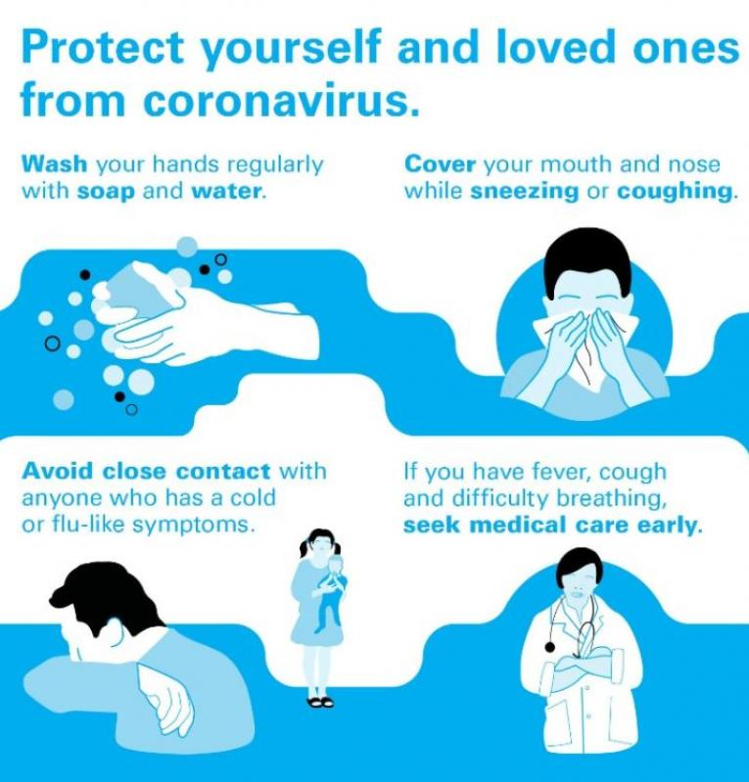

Slide 12


