Slide 1

NIKE

Slide 2
How Was Nike Founded?
The story of Nike begins with the story of Blue Ribbon Sports back in 1964. Around that time, Phil Knight at University of Oregon, ran for the school's track and field team, putting him into contact with their coach, Bill Bowerman. Aside from an intensely competitive ethos, Bowerman displayed a fascination with optimizing his runners' shoes. According to Nike, Knight was the first student to try one of Bowerman's shoes. Seeing him as a safely-unimportant runner to test his shoes on, Bowerman offered to take one of his shoes and fix them up with his custom design. Knight accepted the offer, and, supposedly, the shoes worked so well that his teammate Otis Davis took them and ended up using them to win gold in the 400-meter dash in the 1960 Olympics. Otis Davis insists to this day that Bowerman made the shoes for him.

Slide 3
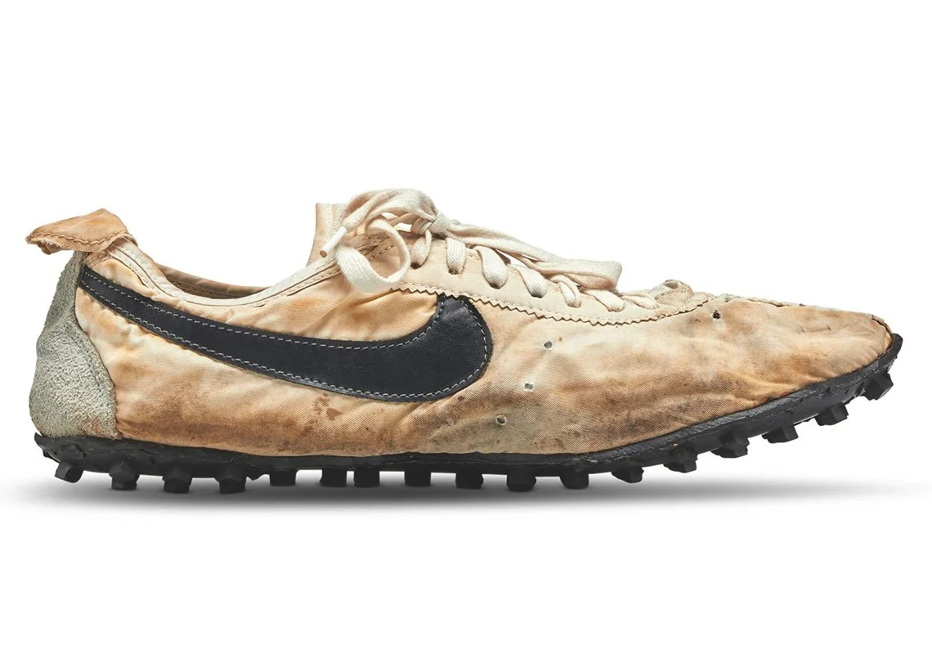

Slide 4
Why was it called NIKE?
The name Nike came to Knight’s colleague Jeff Johnson, who saw Greek goddess Nike in a dream. Her image was one of the reference points for creating a logo. Knight met with designer Carolyn Davidson when he studied at Portland University.
On June 18, 1971, the first Nike shoe went on sale.

Slide 5
Logo history
The wing shape was not the first Davidson idea. She created several sketches at once. And as a result, the Swoosh was invented. One way or another, but the shareholders chose this particular sign as a logo. Phil Knight was dismissive of that logo; he said that isn’t what he dreams about.
The Nike logo designer received a precious ring with the Swoosh as a reward, as well as 500 company shares, it was a huge, albeit belated, award.

Slide 6
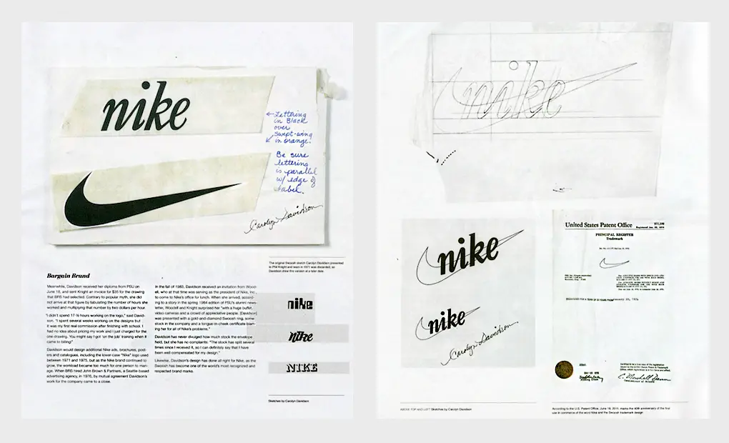

Slide 7
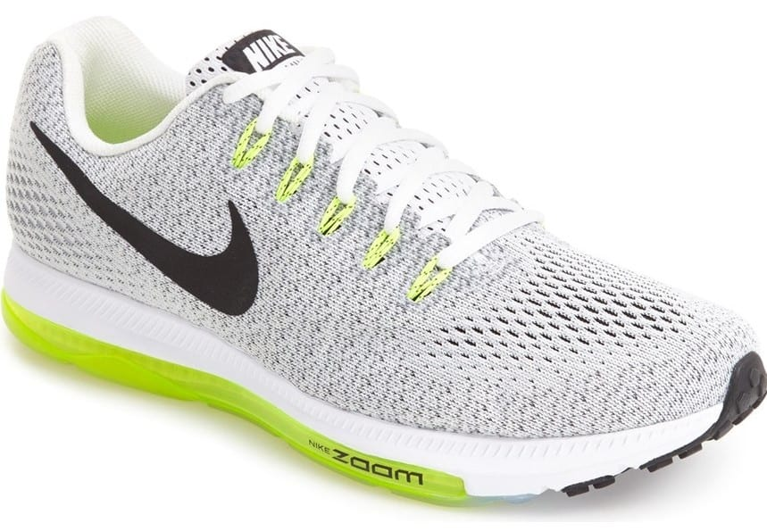
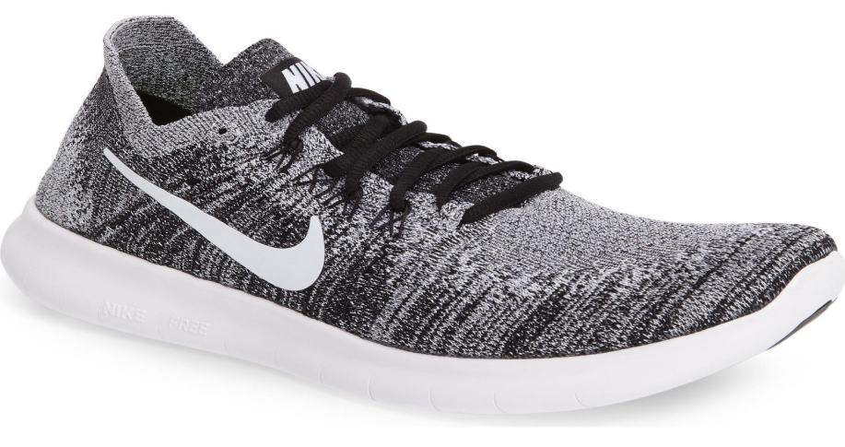

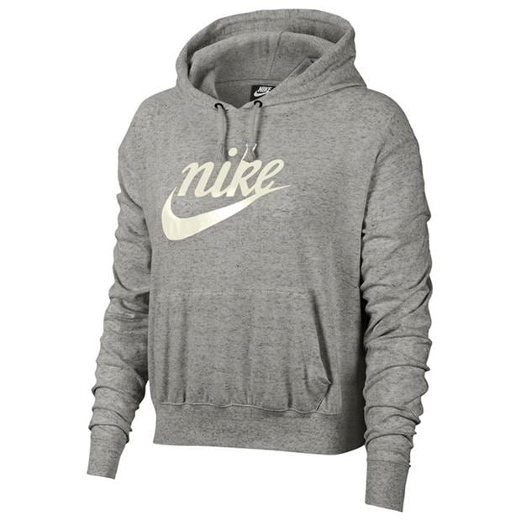
Nike goods forward

Slide 8
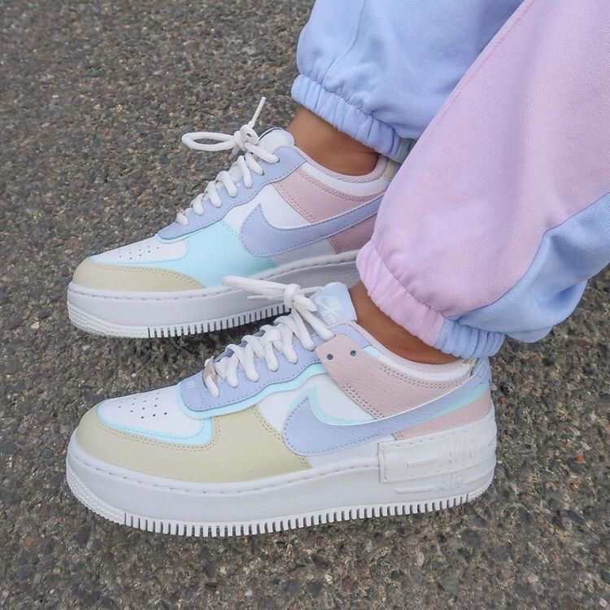


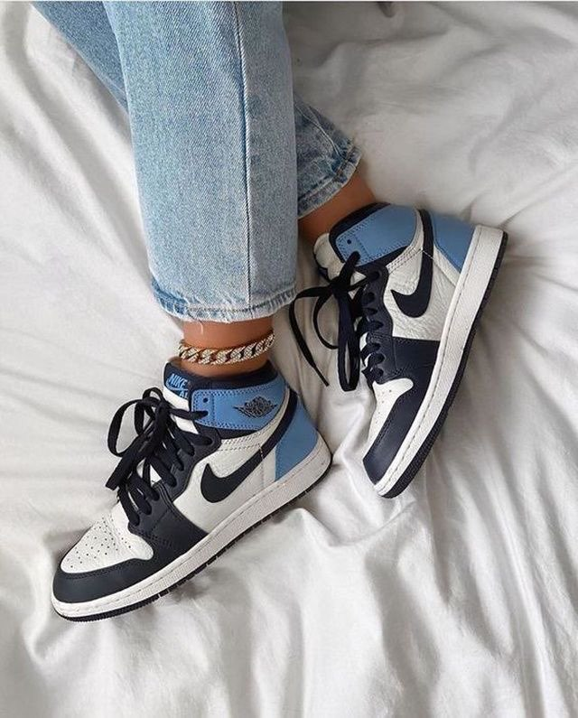
Nike goods now

