Slide 1

Education in Britain
Qnarik Hakobyan

Slide 2
Questions
At what age do children go to school in Britain?
What are the different types of secondary school?
Why are 'public' schools so called?
What is the oldest university in Britain?

Slide 3
At what age do children go to school in Britain?
Children in Britain generally attend school from the age of 5 until they're 16. Before the start of formal schooling, many children attend nursery schools or nursery classes attended to primary schools. In addition, some parents elect to send their children to private nursery schools or kindergartens. In England and Wales, many primary schools also operate an early admission policy where they admit children under 5 into what are cold reception classes
Children first attend the infants’ school or department. At 7 they move to the junior school and the usual age for transfer from junior to secondary school is 11. In some areas, however, ‘first’ schools take pupils aged 5 to 8, 9 or 10, and pupils within the 8 to 14 age range go to ‘middle’ schools.

Slide 4
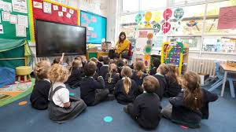


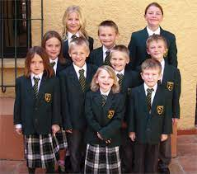
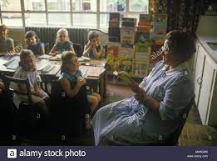


Slide 5
What are the different types of secondary school?
Over 87 per cent of secondary school pupils go to comprehensive schools. These take children of all abilities, and provide a wide range of secondary education for all or most of the children in a district from the age of 11 to 16 оr 18.
Grammar schools offer a mainly aсademic education for the 11 to 18 year age group. Children enter grammar schools on the basis of their abilities, first sitting an entrance examination. Grammar schools cater for just over four per cent of children in secondary education.
A small minority of children attend secondary modern schools. These schools provide a more general and technical education for children aged 11-16.
City Technology Colleges aim to give boys and girls a broad secondary education with a strong technological and business slant. They are non-fee-paying independent schools, set up by the Government with the help of business sponsors who finance a large proportion of the initial capital costs and develop links with the schools. There are now 15 such colleges in operation in England.
City Academies are publicly funded independent schools sponsored by private and voluntary organizations. Their aim is to offer new responses to the school failure that sometimes occurs in city areas.
Specialist schools, which only operate in England, give pupils a broad secondary education with a strong emphasis on technology, languages, arts, sports, business and enterprise, engineering, science, or mathematics and computing. There are over 990 specialist schools. They charge no fees and any secondary school can apply for specialist school status.

Slide 6




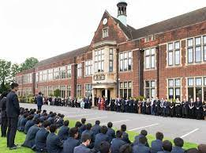

Slide 7
Why are 'public' schools so called?
The independent school sector is separate from the state educational system, and caters for some seven per cent of all schoolchildren in England and four per cent in Scotland. There are 2,400 independent schools in the UK.
Parents of pupils attending independent schools pay for their education, and in some cases fees can amount to several thousand pounds a year. Some pupils gain scholarships and their expenses are covered by the schools.
About 250 of the larger independent schools are known for historical reasons as public schools. Eton, which was founded in 1440, is said to have been the first grammar school to be called a 'public school' because scholars could come to it from any part of England and not, as was generally the case, just from the immediate neighbourhood.
Originally, many public schools stressed classical education, character training and sports, but the curriculum is now closely allied to state education.
In Northerm Ireland there are a few independent fee paying schools catering for very small proportion of the school population; they do not receive any support from public funds.
Schools in Scotland supported by public funds are also called public schools' but they are not fee-paying, independent schools.

Slide 8
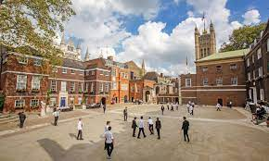
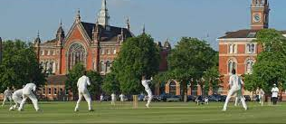
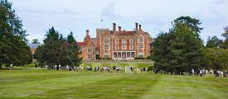
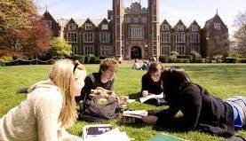

Slide 9
What is the oldest university in Britain?
The University of Oxford was the first university to be established in Britain. Dating from the 12th century, it is organized as a federation of colleges which are governed by their own teaching staff known as 'Fellows'. The oldest college, University College, was founded in 1249. Other notable colleges include All Souls, Christ Church, the college chapel of which is also Oxford Cathedral, and Lady Margaret Hall, which was the first women's college.
Today Oxford University is made up of 39 separate colleges, of which one is for women students only, and the rest take All Souls College, Oxford both men and women.
In 1209, scholars running away from riots in Oxford set up the first academic community in Cambridge. The University is also organized as a federation of colleges, the oldest, Peterhouse, dates from 1284. The largest college, Trinity, was founded by King Henry VIII in 1546.
Scotland also boasts a number of long-established universities. By the end of the Middle Ages Scotland had four universities at Edinburgh. Glasgow, Aberdeen and St Andrew's.
The University of Wales was founded in 1893. It consists of six colleges, the oldest one being the University of Wales, Lampeter, founded as St David's College in 1822. The Queen's University of Belfast was founded in 1845 as one of the three 'Queen's Colleges in Ireland'. It received its charter as a separate university in 1908.

Slide 10
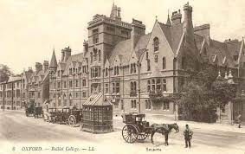
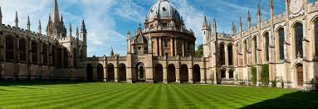
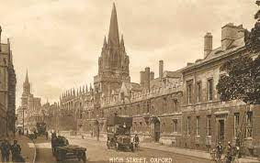

Slide 11
The end

